Slide 1


Slide 2





Slide 3


Slide 4

Youssef Rayhan
Wafaa Gamal
Mostafa Ashraf
Ahmed Ramzy
Khalid Elabd

Slide 5
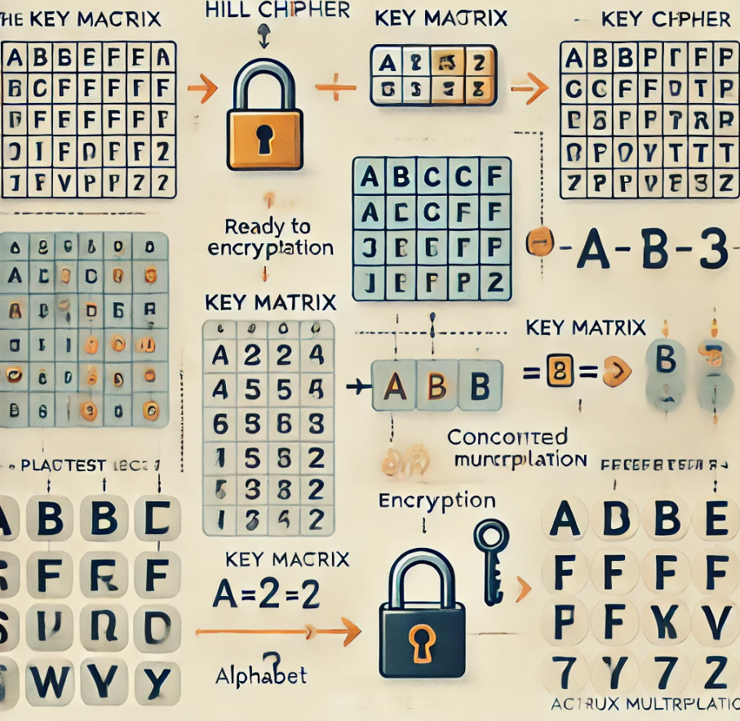

Introducing the Hill Cipher
The Hill Cipher, a cornerstone of modern cryptography, revolutionized encryption techniques. This polyalphabetic substitution cipher introduced matrix-based encoding, setting the stage for advanced cryptographic algorithms.
Youssef Rayhan

Slide 6
Lester S. Hill: The Inventor
1
1929
Hill published his cipher.
2
1930s
Hill became a professor at Hunter College.
3
1960s
Hill's cipher was used by the U.S. military.

Slide 7
Impact on Modern Cryptography
Early Innovation
Hill Cipher established the use of linear algebra in encryption techniques.
Inspiration for Advanced Algorithms
It paved the way for more complex cryptographic systems used today.
Educational Tool
The cipher serves as a practical example for teaching cryptography principles.

Slide 8
Principles and Process
The Hill Cipher is a polygraphic substitution cipher based on linear algebra. It uses matrices and modular arithmetic to encrypt and decrypt messages.
Wafaa Gamal

Slide 9
Foundations in Linear Algebra
Define Linear Algebra
1
Understand the mathematical laws governing multi-dimensional quantities.
2
Introduce Matrices
Learn about ordered arrays of numbers in rows and columns.
Apply Matrix Multiplication
3
Use dot product of rows and columns for encryption.

Slide 10
Converting Letters to Numbers
In Hill Cipher, letters are converted to numbers using a simple system: A = 0, B = 1, C = 2, ..., Z = 25. This conversion is crucial as it allows for the necessary mathematical operations to encrypt texts. For example, the plaintext "HI" would convert to 7 and 8 respectively.
This numerical system forms the basis for all subsequent encryption and decryption processes in the Hill Cipher method.
A
B
C
D
E
0
1
2
3
4
F
G
H
I
J
5
6
7
8
9

Slide 11
Key Concepts: Inverse Matrix and Determinant
Two crucial concepts in Hill Cipher are the inverse matrix and determinant. The inverse matrix, when multiplied by the original matrix, results in the identity matrix. It's essential for decryption - without an invertible matrix, decryption is impossible.
The determinant, a numerical value calculated from a square matrix, indicates matrix properties like invertibility. In Hill Cipher, the determinant must be non-zero and coprime with 26 (the number of letters in the English alphabet) to ensure the matrix is invertible and usable as a key.
Inverse Matrix
Determinant
Essential for decryption. Must be calculable for the chosen key matrix.
Must be non-zero and coprime with 26. Indicates matrix invertibility.

Slide 12





Encryption Process
Choose Key Matrix
Divide Text into Blocks
Select an invertible square matrix.
Block size equals matrix size.
Convert Text to Numbers
Encrypt Using Matrix Multiplication
Use the conversion table (A=0, B=1, etc.).
Multiply blocks by key matrix, use modulo 26.
Convert Back to Text
Obtain final ciphertext.

Slide 13
Decryption Process
1
Calculate Inverse Matrix
2
Convert Ciphertext to Numbers
Use methods like Jordan-Gauss to compute the inverse of the key matrix.
Use the same conversion table as in encryption.
3
Multiply by Inverse Matrix
4
Convert Result to Text
Apply modulus 26 to all calculations.
Reveal the original plaintext message.

Slide 14

Encryption
Transforming messages into secret code using matrices.
Ahmed Ramzy

Slide 15
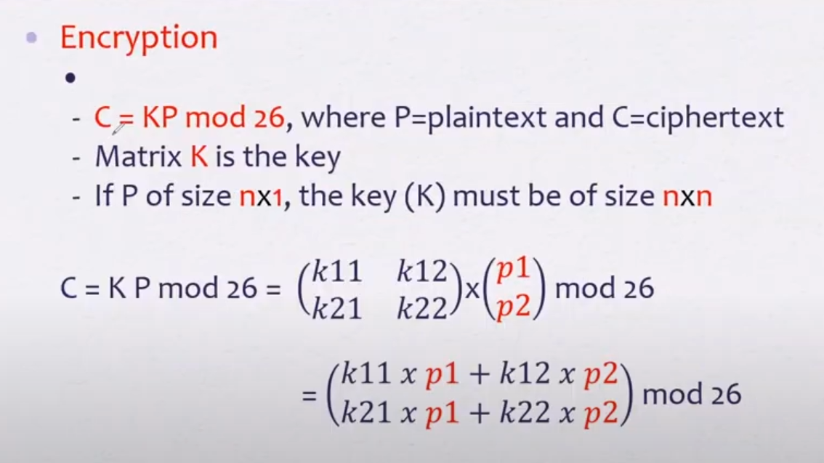

Slide 16
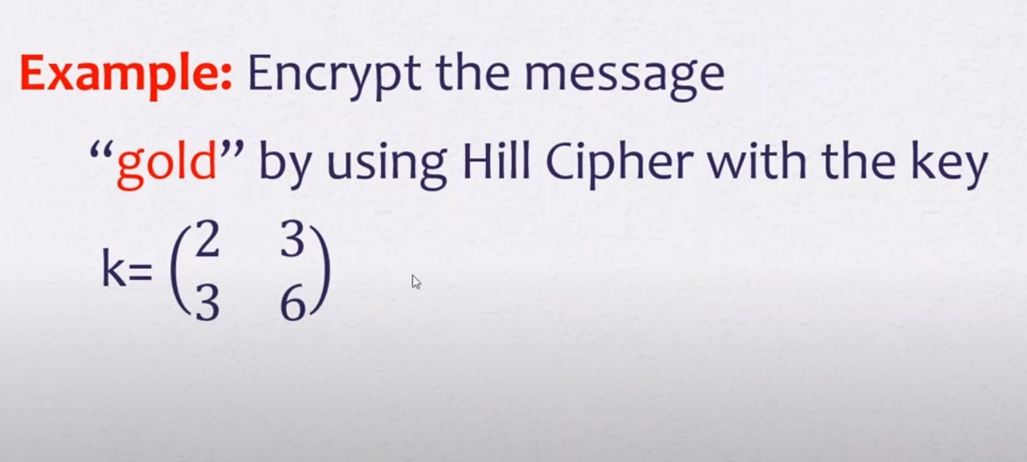

Slide 17
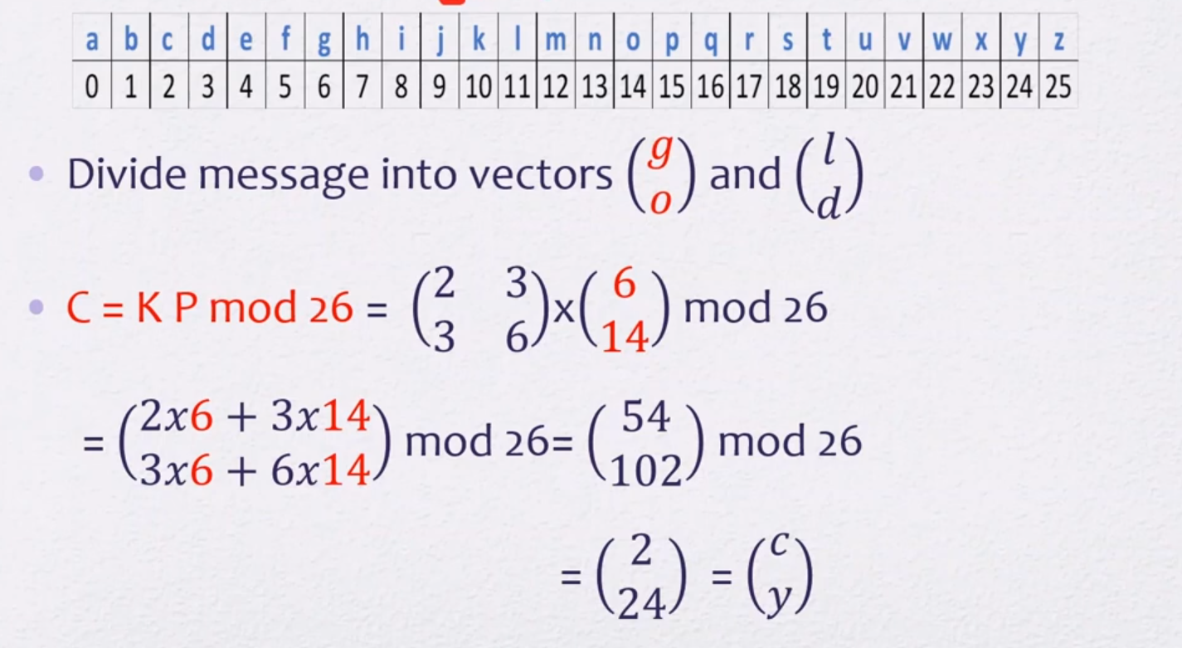

Slide 18
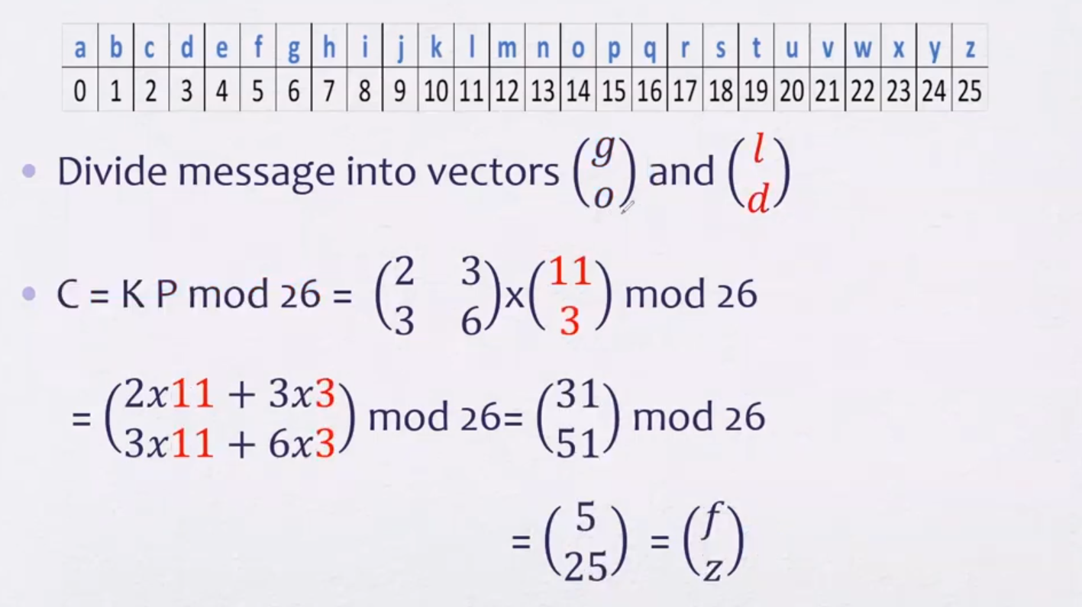

Slide 19
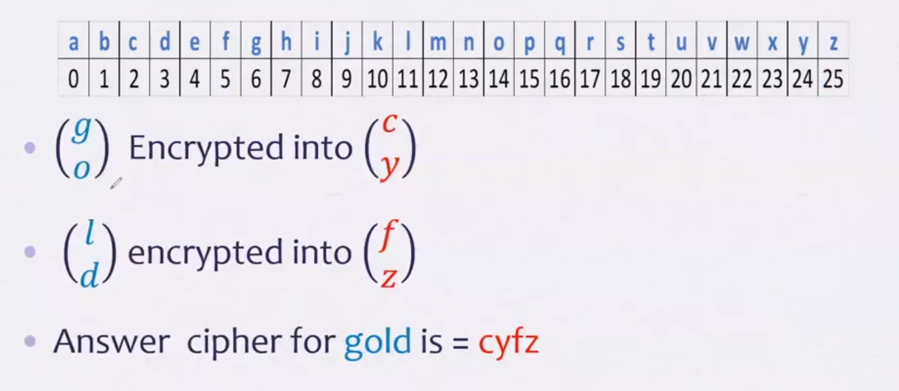

Slide 20
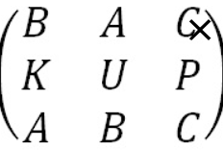
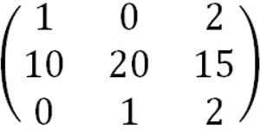
Another example
Plaintext : “retreat now”
Key : backup”
First step :
Note : key phrase is a few letters short, so we fill in the final elements with the start of the alphabet.

Slide 21

Decryption
Transforming secret code into messages.
Khalid Elabd

Slide 22
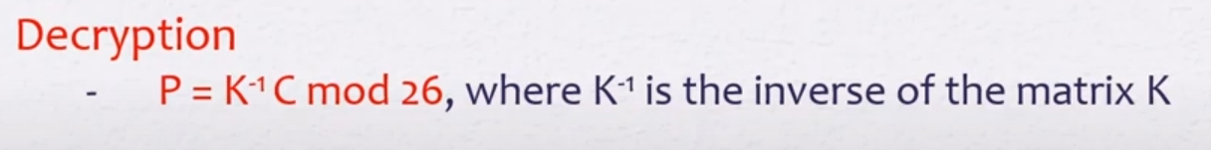

Slide 23
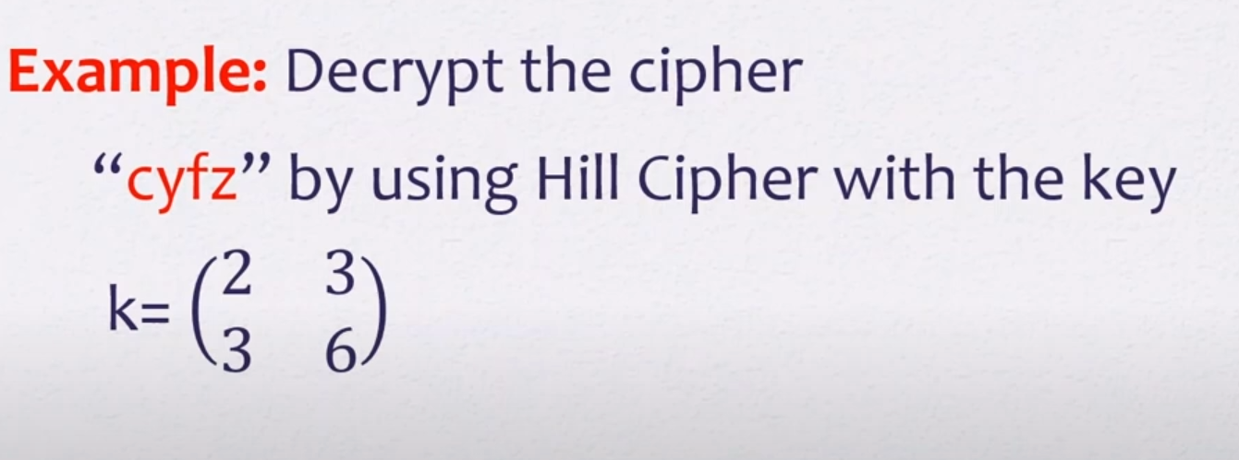

Slide 24
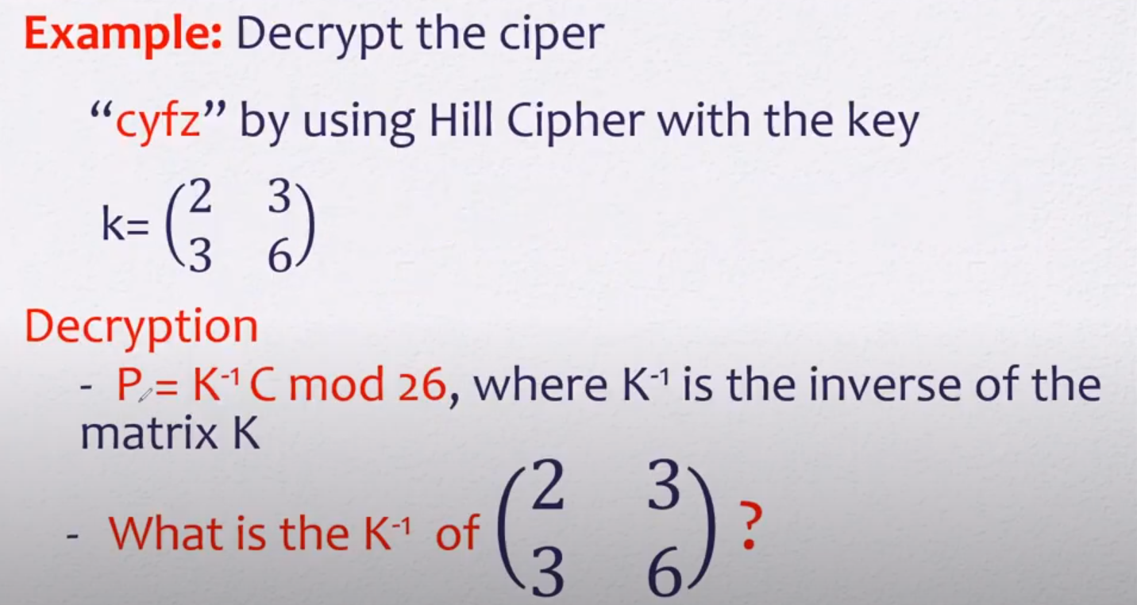

Slide 25
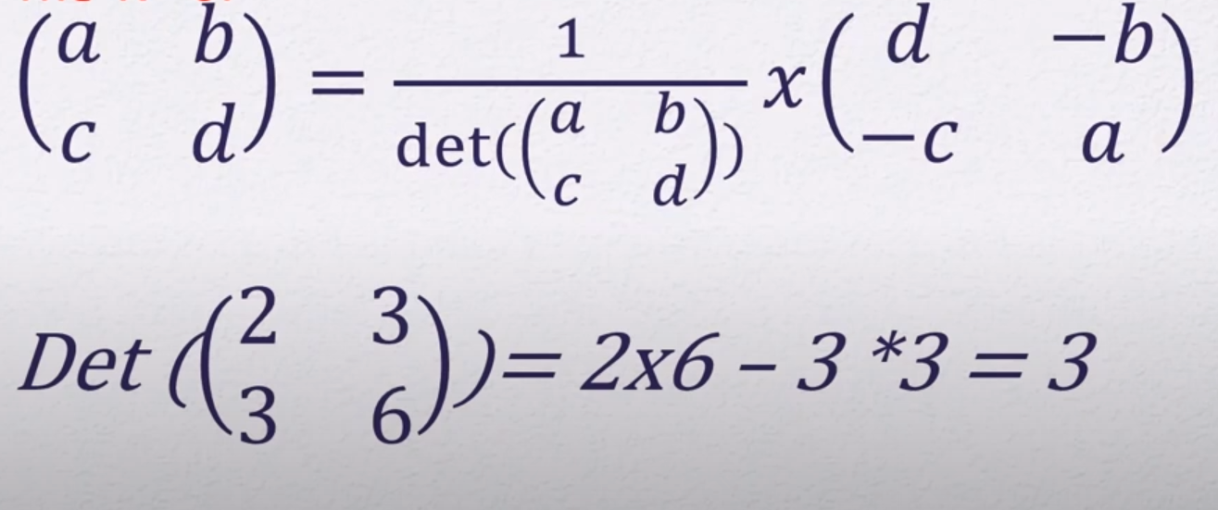

Slide 26
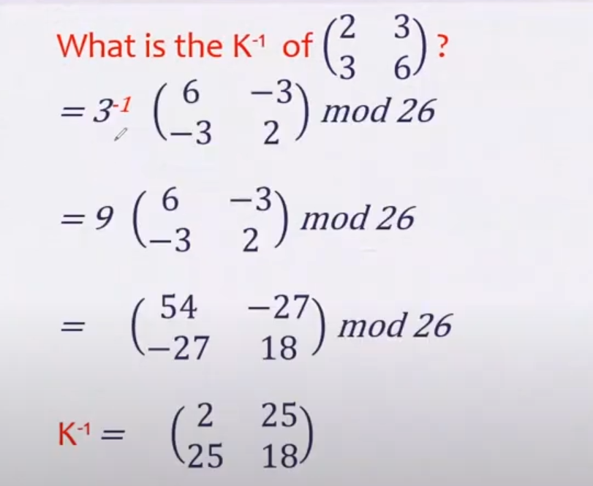

Slide 27
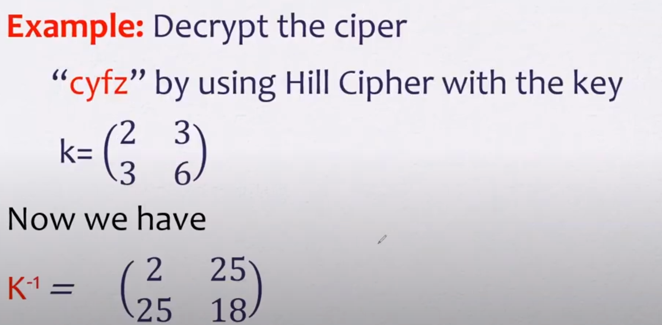

Slide 28
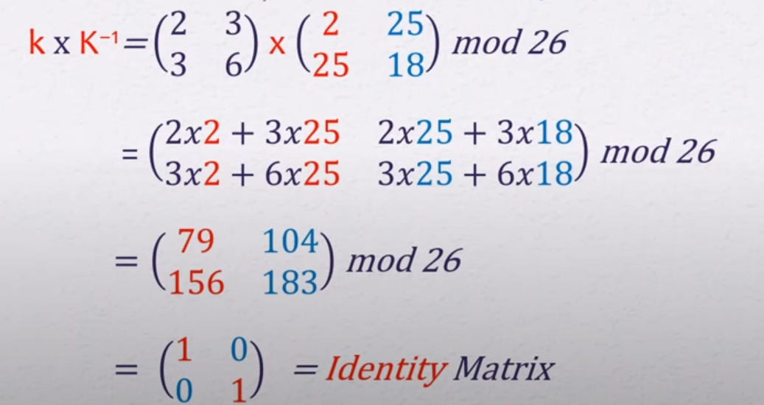

Slide 29
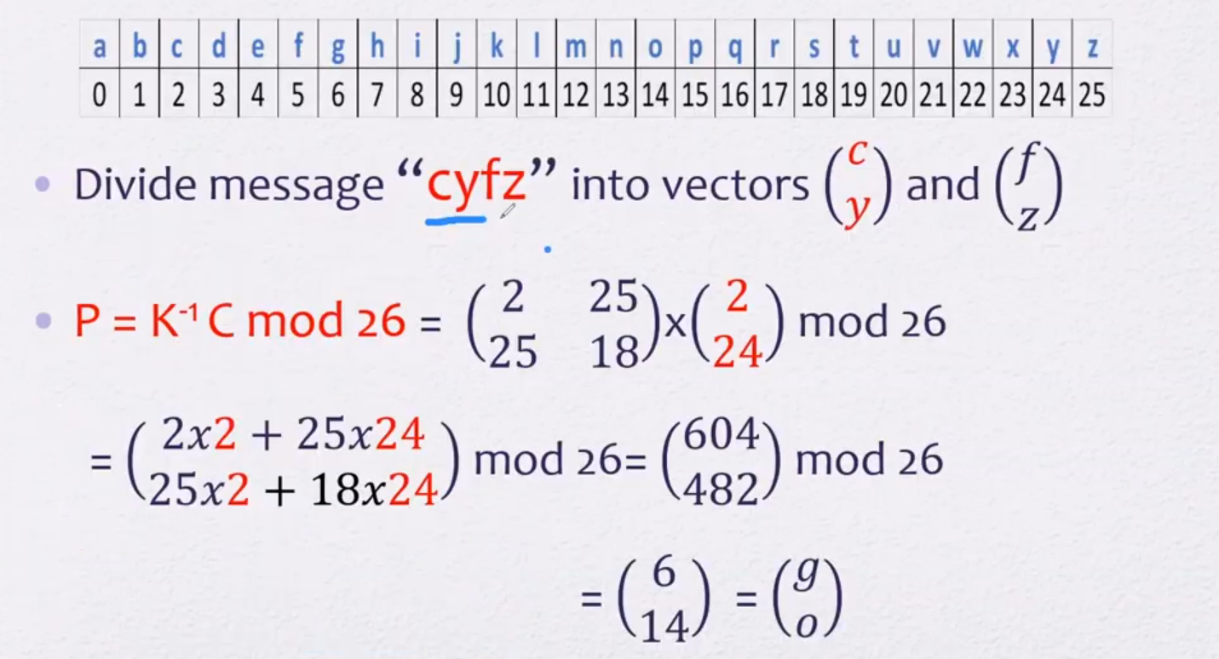

Slide 30
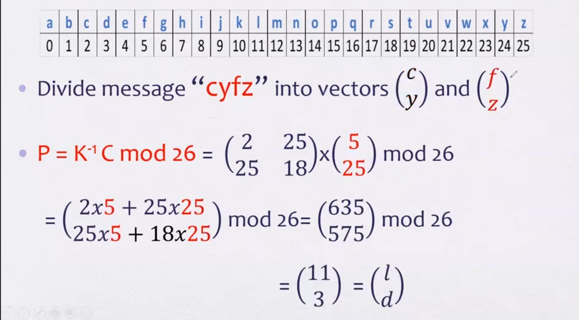

Slide 31
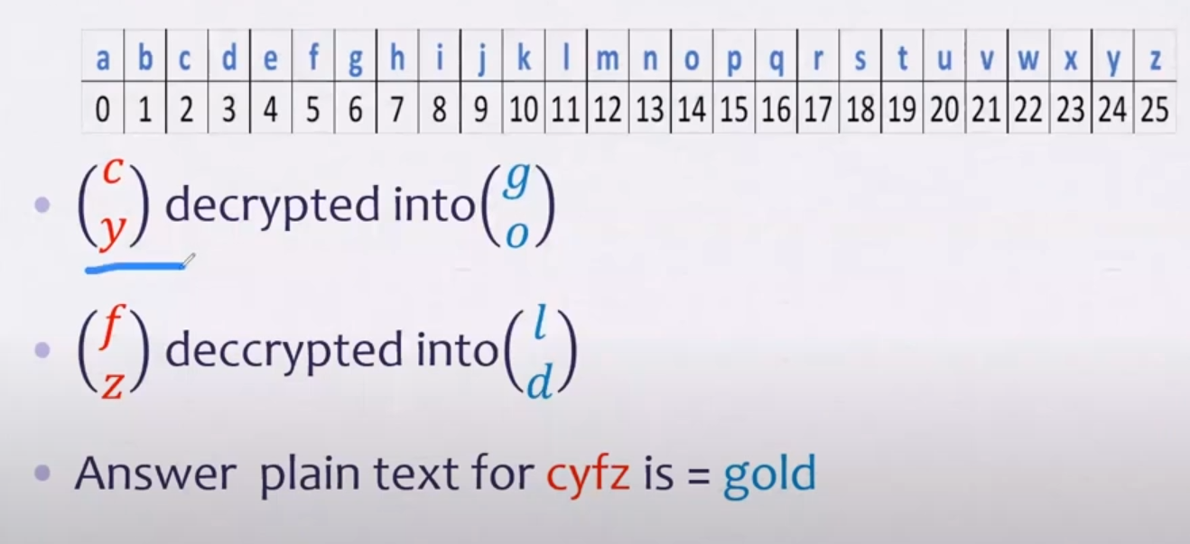

Slide 32

Advantages and Disadvantages
Hill Cipher is a classical symmetric-key cryptographic algorithm that offers strong text encryption, but also faces certain vulnerabilities. In this presentation, we'll explore the advantages, disadvantages, and real-world applications of this versatile encryption technique.
Mostafa Ashraf

Slide 33
Advantages of Hill Cipher
1. Multiple Letter Encryption
2. Linear Algebra Implementation
3. Ease of implementation
Encrypts multiple letters simultaneously rather than one at a time .Makes it stronger than single-letter substitution ciphers like
Uses mathematical matrices for encryption
Employs matrix multiplication operations
Hill cipher is easy to implement programmatically
4. Encryption Key
5. Computational Efficiency
6. Resistance to Analysis
Key is an invertible square matrix
Can choose different matrix sizes
Larger matrix size increases encryption strength
Fast execution compared to some other encryption algorithms
Suitable for high-performance applications
Difficult to break using traditional attacks
Resistant to simple frequency analysis

Slide 34
Disadvantages of Hill Encryption
1. Weak Security with Small Matrices
2. Restrictions on characters used
Typically, small matrices (like 2×2 or 3×3) are used in Hill Cipher encryption, which makes it vulnerable to brute-force attacks.
Works only with alphabetic characters
Difficulty handling numbers and special symbols
Limited data type support
3. Key Management Problems
4. Text Size Constraints
Relatively large key size
Difficult to memorize or store keys
Text length must be multiple of matrix size
May require padding characters

Slide 35
Comparison | Hill Cipher | Monoalphabetic Cipher
Method Used | Based on linear algebra and matrices. | Based on replacing each letter with a fixed substitute.
Encryption Strength | Relatively strong; difficult to break using frequency analysis. | Relatively weak; can be easily broken using frequency analysis.
Security | Provides higher security due to complex mathematical operations. | Less secure due to lack of complex substitution.
Speed | Relatively slower due to complex calculations. | Very fast due to simple substitution.
Substitution per Character | Uses multiple character substitution (block cipher). | Single-letter substitution.

Slide 36

Applications of Hill Cipher
Multimedia Applications:
Digital image encryption
Visual content protection
Audio data encryption
Academic and Educational:
Teaching basic cryptography concepts
Secure Text Communication:
Instant messaging applications
Encrypted email systems
Military communications
Digital Image Encryption:
Effective for image encryption due to matrix-based operations

Slide 37
Encryption plain text = “ CODE “ By using key = [3 7 ] [5 12]

Slide 38
Decryption Cipher text= “AWLL” By using key = [3 7] [5 12]

Slide 39


